Slide 1

CSE 473: Pattern Recognition

Slide 2
Unsupervised Learning:
Clustering

Slide 3
What is Cluster Analysis?
Finding groups of objects such that the objects in a group will be similar (or related) to one another and different from (or unrelated to) the objects in other groups
Inter-cluster distances are maximized
Intra-cluster distances are minimized

Slide 4
Applications
Understanding
  Biological taxonomy
  Group related documents for browsing
  Group genes and proteins that have similar functionality
  Group stocks with similar price fluctuations
Summarization
  Reduce the size of large data sets
Data Compression
  Vector quantization
Finding nearest neighbor

Slide 5
Applications .. .
Hypothesis generation
  To infer some hypothesis
Hypothesis testing
  To verify an existing hypothesis
  Example: ‘big companies invest overseas’
Prediction based on groups
  Predict unknown patterns

Slide 6
What is not Cluster Analysis?
Supervised classification
  Have class label information
Simple segmentation
  Dividing students into different registration groups alphabetically, by last name
Results of a query
  Groupings are a result of an external specification

Slide 7
Clustering Basis
Basic Concepts
a clustering criterion must first be adopted.
Different criteria lead to different clusters.

Slide 8
Notion of a Cluster can be Ambiguous
  Depending on the similarity measure, the clustering criterion and the clustering algorithm, different clusters may result. Subjectivity is a reality to live with from now on.

Slide 9
Notion of a Cluster can be Ambiguous
  Depending on the similarity measure, the clustering criterion and the clustering algorithm, different clusters may result. Subjectivity is a reality to live with from now on.
How many clusters?
Six Clusters
Two Clusters
Four Clusters

Slide 10
Notion of a Cluster can be Ambiguous
Let these animals to be clustered
  Blue shark, sheep, cat, Dog, Lizard, sparrow, viper, seagull, gold fish, frog, red mullet

Slide 11
  A real example
Blue shark,
sheep, cat,
dog
Lizard, sparrow, viper, seagull, gold fish, frog, red mullet
Two clusters
Clustering criterion:
How mammals bear
their progeny
Gold fish, red mullet, blue shark
Sheep, sparrow,
dog, cat, seagull,
lizard, frog, viper
Two clusters
Clustering criterion:
Existence of lungs

Slide 12
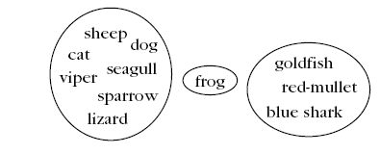
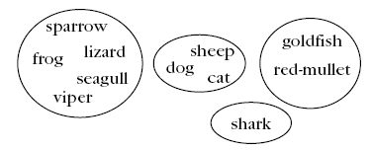
  A real example
Three clusters
Clustering criterion:
Their living
environment
Four clusters
Clustering criterion:
Bear progeny and Existence of lungs

Slide 13
Clustering Task Stages
  Feature Selection: Information rich features-Parsimony
  Proximity Measure: This quantifies the term similar or dissimilar.
  Clustering Criterion: This consists of a cost function or some type of rules.
  Clustering Algorithm: This consists of the set of steps followed to reveal the structure, based on the similarity measure and the adopted criterion.
  Validation of the results.
  Interpretation of the results.

Slide 14
Types of Features
With respect to their domain
  Continuous (the domain is a continuous subset of ℜ).
  Discrete (the domain is a finite discrete set).
    Binary or dichotomous (the domain consists of two possible values).
With respect to the relative significance of the values they take
  Nominal (the values code states, e.g., the home district of an individual).
  Ordinal (the values are meaningfully ordered, e.g., the rating of the services of a hotel (poor, good, very good, excellent)).
  Interval-scaled (the difference of two values is meaningful but their ratio is meaningless, e.g., temperature).
  Ratio-scaled (the ratio of two values is meaningful, e.g., weight).

Slide 15
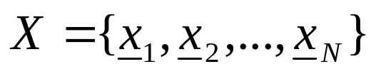
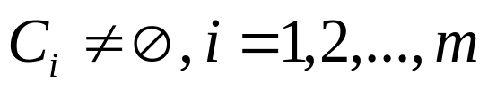
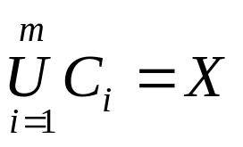
Clustering Definitions
Hard Clustering: Each point belongs to a single cluster
    Let
    An m-clustering R of X, is defined as the partition of X into m sets (clusters), C₁, C₂,…,C_{m}, so that
  In addition, data in C_{i} are more similar to each other and less similar to the data in the rest of the clusters.

Slide 16


Clustering Definitions
  Fuzzy clustering: Each point belongs to all clusters up to some degree.
  A fuzzy clustering of X into m clusters is characterized by m functions
    is the representative of jth cluster

Slide 17
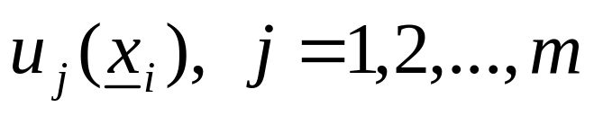
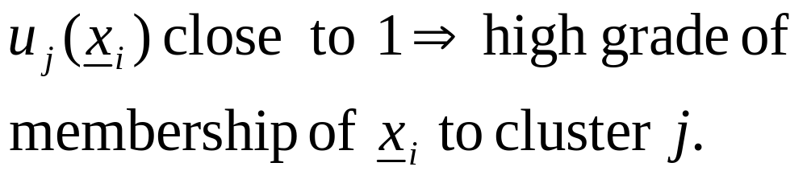
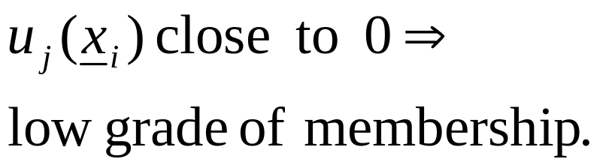
Clustering Definitions
  These are known as membership functions.
  Thus, each x_{i} belongs to any cluster “up to
  some degree”, depending on the value of

Slide 18
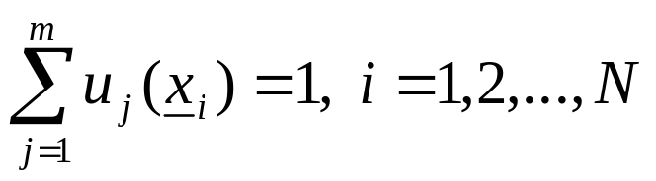
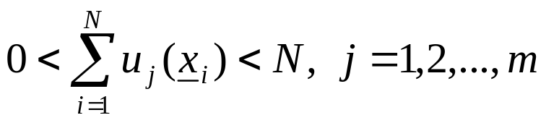
Clustering Definitions
  Fuzzy clustering: Each point belongs to all clusters up to some degree.
  A fuzzy clustering of X into m clusters is characterized by m functions
    is the representative of jth cluster

Slide 19
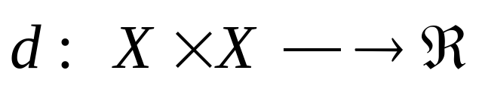
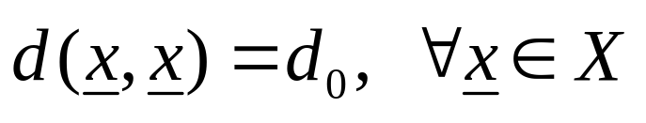
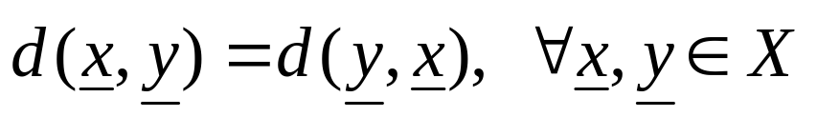
Proximity Measures
Between vectors
  Dissimilarity measure (between vectors of X) is a function
with the following properties

Slide 20
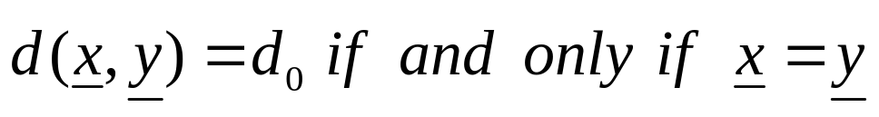
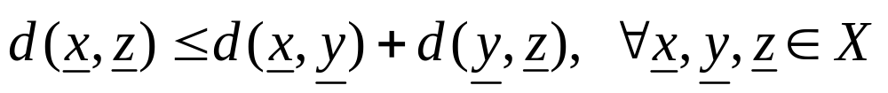
Proximity Measures
If, in addition
  (triangular inequality)
  d is called a metric dissimilarity measure.

Slide 21
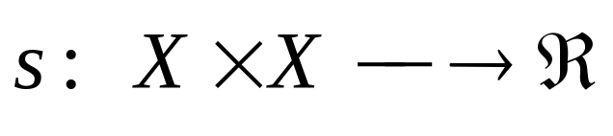
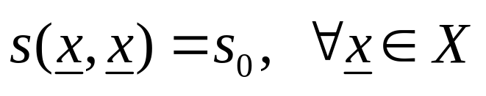
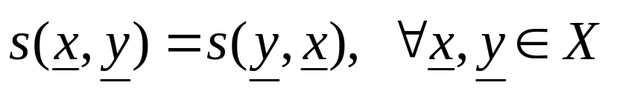
Proximity Measures
  Similarity measure (between vectors of X) is a function
with the following properties

Slide 22
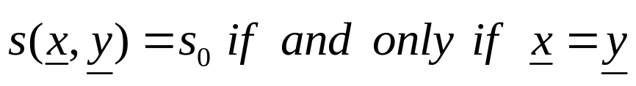
Proximity Measures
If, in addition
  s is called a metric similarity measure.

Slide 23
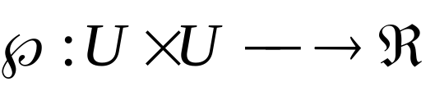
Proximity Measures
Between sets
Let D_{i} ⊂ X, i=1,…,k and U={D₁,…,D_{k}}
A proximity measure ℘ on U is a function

Slide 24
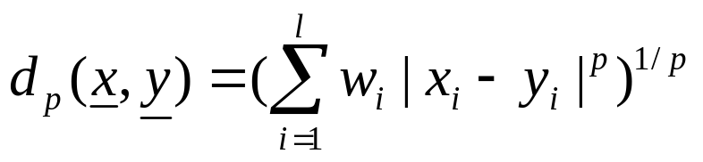
Proximity Measures Between Points/Vectors
Real-valued vectors
  Dissimilarity measures (DMs)
    Weighted l_{p} metric DMs
    Interesting instances are obtained for
      p=1 (weighted Manhattan norm)
      p=2 (weighted Euclidean norm)
      p=∞ (d∞(x,y)=max_{1≤i≤l} w_{i}|x_{i}-y_{i}| )

Slide 25
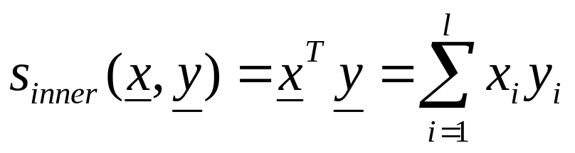
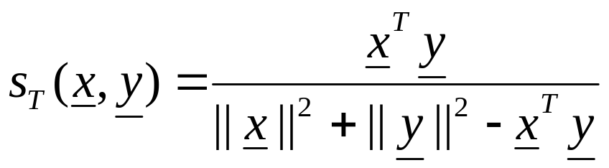
Proximity Measures Between Vectors
  Similarity measures
    Inner product
    Tanimoto measure

Slide 26
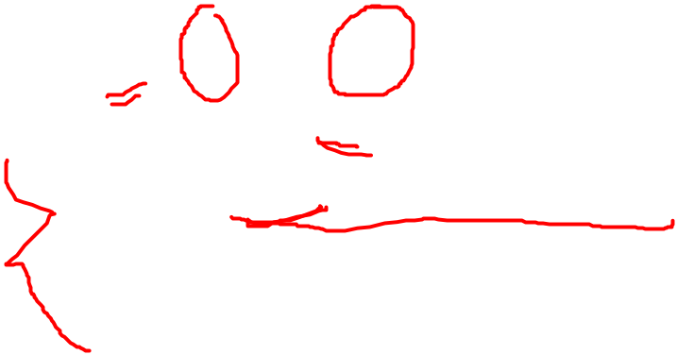

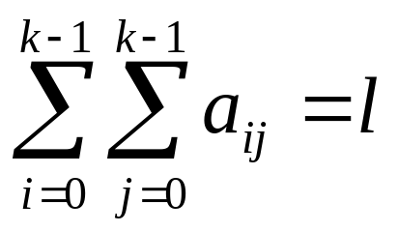
Proximity Measures Between Discrete-Valued Vectors
  Let F={0,1,…,k-1} be a set of symbols and X={x₁,…,x_{N}} ⊂ F^{l}
  Let A(x,y)=[a_{ij}], i, j=0,1,…,k-1, where a_{ij} is the number of places where x has the i-th symbol and y has the j-th symbol.
Example: l=6, k =3
NOTE:

Slide 27
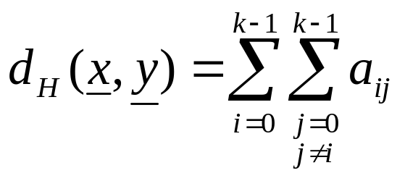
Proximity Measures Between Discrete-Valued Vectors
Several proximity measures can be expressed as combinations of the elements of A(x,y).
  Dissimilarity measures:
    The Hamming distance (number of places where x and y differ)

Slide 28
Proximity Measures Between Discrete-Valued Vectors
Several proximity measures can be expressed as combinations of the elements of A(x,y).
  Dissimilarity measures:
    The Hamming distance (number of places where x and y differ)

Slide 29
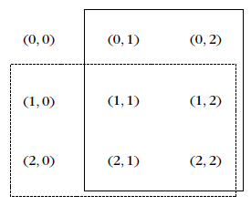
Proximity Measures Between Discrete-Valued Vectors
n_{y}
  Similarity measures:
n_{x}

Slide 30
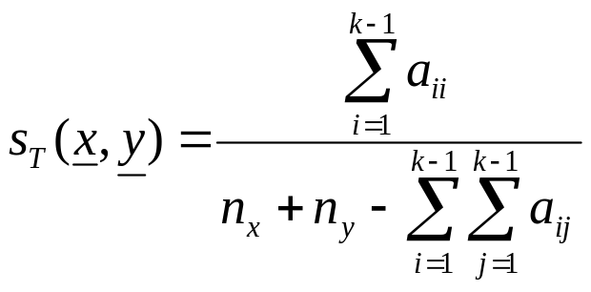
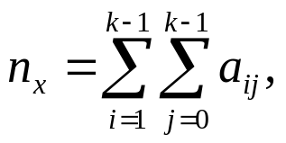
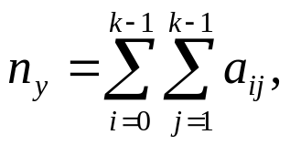
Proximity Measures Between Discrete-Valued Vectors
n_{y}
  Similarity measures:
n_{x}
    Tanimoto measure :
    where

Slide 31
Proximity Measures Between Discrete-Valued Vectors
n_{y}
  Similarity measures:
n_{x}
    Tanimoto measure :
    where

Slide 32
K – Means Clustering
  1. Initialize the center of the clusters
  2. Find the distance from the vectors to all the centers
  3. Assign the vectors to their nearest cluster according to the distance
  4. Find the new center using their mean
  5. Repeat steps 2 to 4 until centers are stationary
  Data(x,y)=(2,5),(3,3),(1,4),(5,5),(5,6),(5,2)
Data(x,y) | C1(x,y) | C2(x,y)
2,5
3,3
1,4
5,5
6,6
5,2

Slide 33
Proximity Measures Between Mixed-Valued Vectors
Some of the coordinates of the vectors x are real and the rest are discrete.
Methods for measuring the proximity between two such x_{i} and x_{j}:
  Adopt a proximity measure (PM) suitable for real-valued vectors.
  Convert the real-valued features to discrete ones and employ a discrete PM.
  The more general case of mixed-valued vectors:
  Here nominal, ordinal, interval-scaled, ratio-scaled features are treated separately.

Slide 34
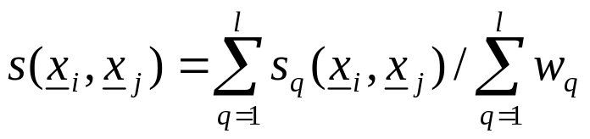
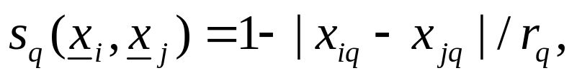
Proximity Measures Between Mixed-Valued Vectors
The similarity function between x_{i} and x_{j} is:
In the above definition:
  w_{q}=0, if one of the q-th coordinates of x_{i} and x_{j} are undefined or both the q-th coordinates are equal to 0. Otherwise w_{q}=1.
  If the q-th coordinates are binary, s_{q}(x_{i},x_{j})=1 if x_{iq}=x_{jq}=1 and 0 otherwise.
  If the q-th coordinates are nominal or ordinal, s_{q}(x_{i},x_{j})=1 if x_{iq}=x_{jq} and 0 otherwise.
  If the q-th coordinates are interval or ratio scaled-valued
  where r_{q} is the interval where the q-th coordinates of the vectors of the data set X lie.

Slide 35
Fuzzy Proximity Measures
Let x, y∈[0,1]^{l}. Here the value of the i-th coordinate, x_{i,} of x, is not the outcome of a measuring device.
  The closer the coordinate x_{i} is to 1 (0), the more likely the vector x possesses (does not possess) the i-th characteristic.
  As x_{i} approaches 0.5, the certainty about the possession or not of the i-th feature from x decreases.

Slide 36
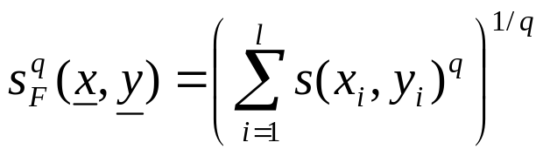
Fuzzy Proximity Measures
A possible similarity measure that can quantify the above is:
Then

Slide 37
Proximity Measures For Missing Data
For some vectors of the data set X, some features values are unknown
Ways to face the problem:
  Discard all vectors with missing values (not recommended for small data sets)
  Find the mean value m_{i} of the available i-th feature values over that data set and substitute the missing i-th feature values with m_{i}.

Slide 38
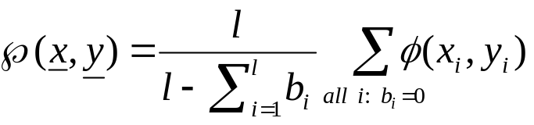
Proximity Measures For Missing Data
  Define b_{i}=0, if both the i-th features x_{i}, y_{i} are available and b_{i}=1 otherwise. Then
  where φ(x_{i},y_{i}) denotes the PM between two scalars x_{i}, y_{i}.

Slide 39
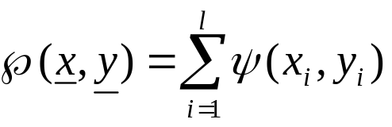
Proximity Measures For Missing Data
  Find the average proximities φ_{avg}(i) between all feature vectors in X along all components. Then
  where ψ(x_{i},y_{i})=φ(x_{i},y_{i}), if both x_{i} and y_{i} are available and φ_{avg}(i) otherwise.

Slide 40
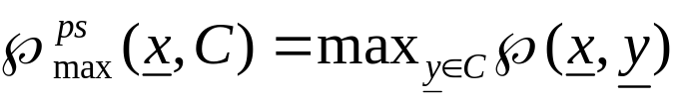

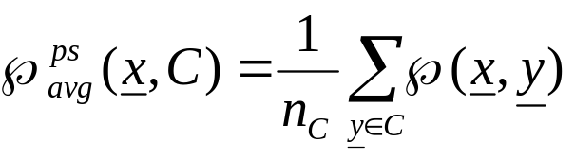
Proximity Functions Between A Vector and A Set
Let X={x₁,x₂,…,x_{N}} and C ⊂ X, x ∈ X
All points of C contribute to the definition of ℘(x, C)
  Max proximity function
  Min proximity function
  Average proximity function
(n_{C} is the cardinality of C)

Slide 41
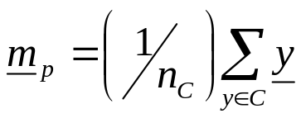
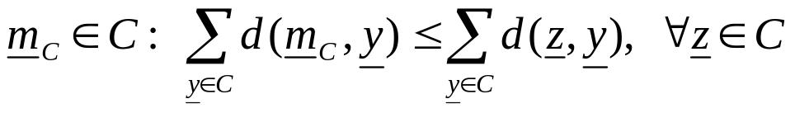
A representative(s) of C, r_{C} , contributes to the definition of ℘(x,C)
In this case: ℘(x,C)=℘(x,r_{C})
Typical representatives are:
  The mean vector:
  The mean center:
  The median center:
NOTE: Other representatives (e.g., hyperplanes, hyperspheres) are useful in certain applications (e.g., object identification using clustering techniques).
where n_{C} is the cardinality of C
d: a dissimilarity measure

Slide 42
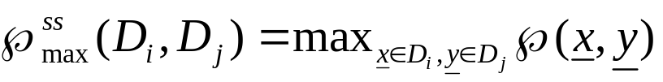

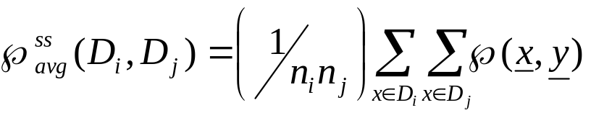
Proximity Functions Between Sets
Let X={x₁,…,x_{N}}, D_{i}, D_{j} ⊂ X and n_{i}=|D_{i}|, n_{j}=|D_{j}|
All points of each set contribute to ℘(D_{i},D_{j})
  Max proximity function
  Min proximity function
  Average proximity function

Slide 43

Proximity Functions Between Sets
Each set D_{i} is represented by its representative vector m_{i}
  Mean proximity function (it is a measure provided that ℘ is a measure):

Slide 44
Remarks:
  Different choices of proximity functions between sets may lead to totally different clustering results.
  Different proximity measures between vectors in the same proximity function between sets may lead to totally different clustering results.
  The only way to achieve a proper clustering is
    by trial and error and,
    taking into account the opinion of an expert in the field of application.

Slide 45
CLUSTERING ALGORITHMS
Number of possible clusterings
Let X={x₁,x₂,…,x_{N}}.
Question: In how many ways the N points can be
assigned into m groups?
Answer: ?

Slide 46

CLUSTERING ALGORITHMS
Number of possible clusterings
Let X={x₁,x₂,…,x_{N}}.
Question: In how many ways the N points can be
assigned into m groups?
Answer: ?
Let S(N, m) = number of possible ways of clusterings
is the list of all possible clusterings of N vectors into m groups

Slide 47
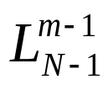
CLUSTERING ALGORITHMS
Number of possible clusterings
Let X={x₁,x₂,…,x_{N}}.
Question: In how many ways the N points can be
assigned into m groups?
Answer: ?
Let S(N, m) = number of possible ways of clusterings
is the list of all possible clusterings of N vectors into m groups
Therefore,
is the list containing all possible clusterings of the N - 1 vectors into m -1 groups

Slide 48
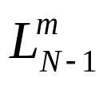
CLUSTERING ALGORITHMS
Number of possible clusterings
Let X={x₁,x₂,…,x_{N}}.
Question: In how many ways the N points can be
assigned into m groups?
Answer: ?
is the list of all possible clusterings of N vectors into m groups
Therefore,
be the list containing all possible clusterings of the N -1 vectors into m-1 groups
be the list containing all possible clusterings of the N -1 vectors into m groups

Slide 49
CLUSTERING ALGORITHMS
Number of possible clusterings
Let X={x₁,x₂,…,x_{N}}.
Question: In how many ways the N points can be
assigned into m groups?
Answer: ?
Now find from and , in two ways:
Either will be added to one of the clusters of any member of
Or will form a new cluster to each member of

Slide 50
CLUSTERING ALGORITHMS
Number of possible clusterings
Let X={x₁,x₂,…,x_{N}}.
Question: In how many ways the N points can be
assigned into m groups?
Answer: ?
Now find from and , in two ways:
Either will be added to one of the clusters of any member of
Or will form a new cluster to each member of
Therefore, S(N, m) = mS(N -1, m) + S(N - 1, m - 1)

Slide 51
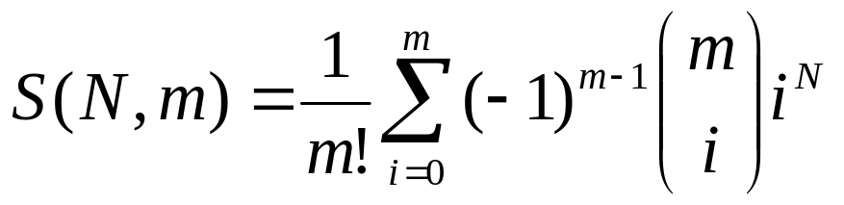
CLUSTERING ALGORITHMS
Number of possible clusterings
Let X={x₁,x₂,…,x_{N}}.
Question: In how many ways the N points can be
assigned into m groups?
Answer:

Slide 52

CLUSTERING ALGORITHMS
Number of possible clusterings
Let X={x₁,x₂,…,x_{N}}.
Question: In how many ways the N points can be
assigned into m groups?
Answer:
  Examples:

Slide 53


CLUSTERING ALGORITHMS
Number of possible clusterings
Let X={x₁,x₂,…,x_{N}}.
Question: In how many ways the N points can be
assigned into m groups?
Answer:
  Examples:

Slide 54

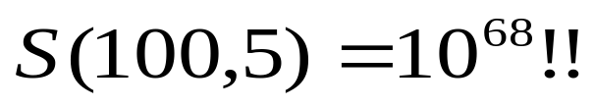
CLUSTERING ALGORITHMS
Number of possible clusterings
Let X={x₁,x₂,…,x_{N}}.
Question: In how many ways the N points can be
assigned into m groups?
Answer:
  Examples:

Slide 55
A way out:
  Consider only a small fraction of clusterings of X and select a “sensible” clustering among them.
    Question 1: Which fraction of clusterings is considered?
    Question 2: What “sensible” means?
    The answer depends on the specific clustering algorithm and the specific criteria to be adopted.

Slide 56
Clustering Algorithms
2 Important distinctions: hierarchical and partitional
Partitional Clustering
  A division data objects into non-overlapping subsets (clusters) such that each data object is in exactly one subset
Hierarchical clustering
  A set of nested clusters organized as a hierarchical tree

Slide 57

Partitional Clustering
Original Points
A Partitional Clustering

Slide 58
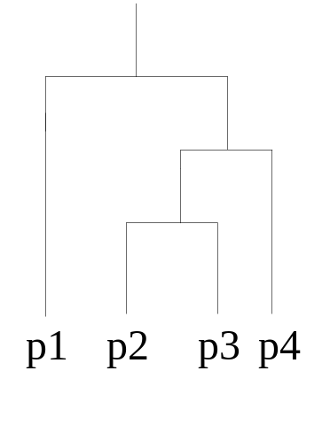
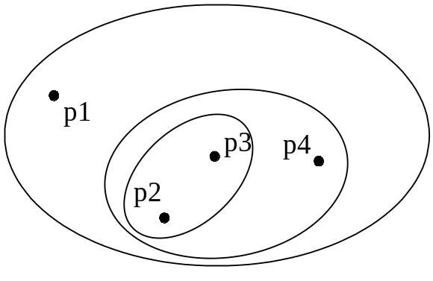
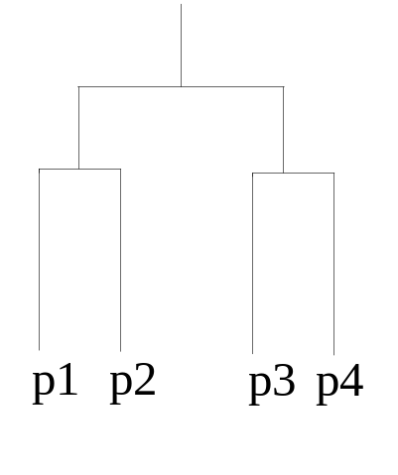
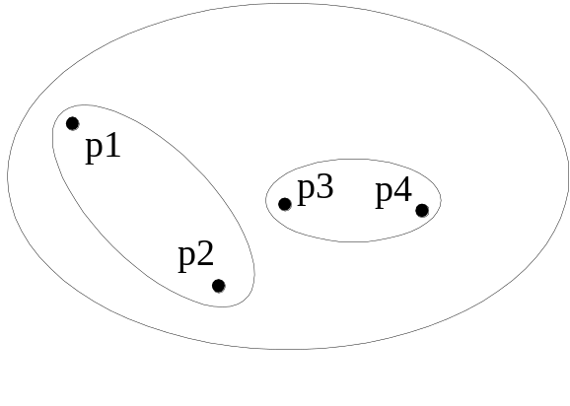
Hierarchical Clustering
Traditional Hierarchical Clustering
Traditional Dendrogram
Non-traditional Hierarchical Clustering
Non-traditional Dendrogram

Slide 59
Hierarchical Clustering
Hierarchical: A sequence of (nested) clusterings is produced.
  Agglomerative
  Divisive
  Combinations of the above (e.g., the Chameleon algorithm.)

Slide 60
OTHER MAJOR CATEGORIES OF CLUSTERING ALGORITHMS
Sequential: A single clustering is produced. One or few sequential passes on the data.

Slide 61
Cost function optimization. For most of the cases a
single clustering is obtained.
  Hard clustering (each point belongs exclusively to a single cluster):
    Basic hard clustering algorithms (e.g., k-means)
    Branch and bound
    Boundary detection
    Genetic clustering algorithms
    …
    ..
    .
  Fuzzy clustering (each point belongs to more than one clusters simultaneously).
  Probabilistic clustering (it is based on the probability of a point to belong to a cluster).

Slide 62
Other schemes:
  Exclusive versus non-exclusive
    In non-exclusive clusterings, points may belong to multiple clusters.
    Can represent multiple classes or ‘border’ points
  Partial versus complete
    In some cases, we only want to cluster some of the data
  Heterogeneous versus homogeneous
    Cluster of widely different sizes, shapes, and densities

Slide 63
Other schemes:
  Algorithms based on graph theory (e.g., Minimum Spanning Tree, regions of influence, directed trees).
  Density based clustering algorithms.
  Subspace clustering algorithms.
  Kernel based methods

Slide 64
Clustering and Clusters :Difference?
Types of Clusters
Well-separated clusters
Center-based clusters
Contiguous clusters
Density-based clusters
Property or Conceptual
Described by an Objective Function

Slide 65
Types of Clusters: Well-Separated
Well-Separated Clusters:
  A cluster is a set of points such that any point in a cluster is closer (or more similar) to every other point in the cluster than to any point not in the cluster.
B
A
C
3 well-separated clusters

Slide 66
Types of Clusters: Center-Based
Center-based
  A cluster is a set of objects such that an object in a cluster is closer (more similar) to the “center” of a cluster, than to the center of any other cluster
  The center of a cluster is often a centroid, the average of all the points in the cluster, or a medoid, the most “representative” point of a cluster
A
C₂
C₁
4 center-based clusters

Slide 67
Types of Clusters: Contiguity-Based
Contiguous Cluster (Nearest neighbor or Transitive)
  A cluster is a set of points such that a point in a cluster is closer (or more similar) to one or more other points in the cluster than to any point not in the cluster.
8 contiguous clusters

Slide 68
Types of Clusters: Density-Based
Density-based
  A cluster is a dense region of points, which is separated by low-density regions, from other regions of high density.
  Used when the clusters are irregular or intertwined, and when noise and outliers are present.
Area of low density
Area of high density
6 density-based clusters

Slide 69
Types of Clusters: Conceptual Clusters
Shared Property or Conceptual Clusters
  Finds clusters that share some common property or represent a particular concept.
2 Overlapping Circles

Slide 70
SEQUENTIAL CLUSTERING ALGORITHMS
Characteristics:
  One or very few passes on the data
  No a-prior knowledge about the number of clusters
  The clusters are defined with the aid of
    An appropriately defined distance d (x,C) of a point from a cluster.
    A threshold Θ associated with the distance.

Slide 71
Basic Sequential Clustering Algorithm (BSAS)
  m=1 \ {number of clusters}\
  C_{m}={x₁}
  For i=2 to N
    Find C_{k}: d(x_{i},C_{k})=min_{1≤j≤m}d(x_{i},C_{j})
    If (d(x_{i},C_{k})>Θ) AND (m<q) then
      m=m+1
      C_{m}={x_{i}}
    Else
      C_{k}=C_{k}∪{x_{i}}
      Where necessary, update representatives (*)
    End {if}
  End {for}

Slide 72
Basic Sequential Clustering Algorithm (BSAS)
  m=1 \{number of clusters}\
  C_{m}={x₁}
  For i=2 to N
    Find C_{k}: d(x_{i},C_{k})=min_{1≤j≤m}d(x_{i},C_{j})
    If (d(x_{i},C_{k})>Θ) AND (m<q) then
      m=m+1
      C_{m}={x_{i}}
    Else
      C_{k}=C_{k}∪{x_{i}}
      Where necessary, update representatives (*)
    End {if}
  End {for}
(*) When the mean vector m_{C} is used as representative of the cluster C with n_{c} elements, the updating in the light of a new vector x becomes
m_{C}^{new}=(n_{C} m_{C} + x) / (n_{C}+1)

Slide 73
Remarks:
  The order of presentation of the data in the algorithm plays important role in the clustering results.
    Different order of presentation may lead to totally different clustering results

Slide 74
Remarks:
  The order of presentation of the data in the algorithm plays important role in the clustering results.
    Different order of presentation may lead to totally different clustering results
  In BSAS the decision for a vector x is reached prior to the final cluster formation.

Slide 75
Remarks:
  The order of presentation of the data in the algorithm plays important role in the clustering results.
    Different order of presentation may lead to totally different clustering results
  In BSAS the decision for a vector x is reached prior to the final cluster formation.
  BSAS perform a single pass on the data. Its complexity is O(N).

Slide 76
Estimating the number of clusters in the data set:
25
15
5
-5
-5
5
15
25

Slide 77
Estimating the number of clusters in the data set:
Let BSAS(Θ) denote the BSAS algorithm when the dissimilarity threshold is Θ.
  Find
    a, the maximum and
    b, the minimum distances among the points
25
15
5
-5
-5
5
15
25

Slide 78
Estimating the number of clusters in the data set:
Let BSAS(Θ) denote the BSAS algorithm when the dissimilarity threshold is Θ.
  For Θ=a to b step c
    Run s times BSAS(Θ), each time presenting the data in a different order.
    Estimate the number of clusters m_{Θ}, as the most frequent number resulting from the s runs of BSAS(Θ).
  Next Θ
25
15
5
-5
-5
5
15
25

Slide 79
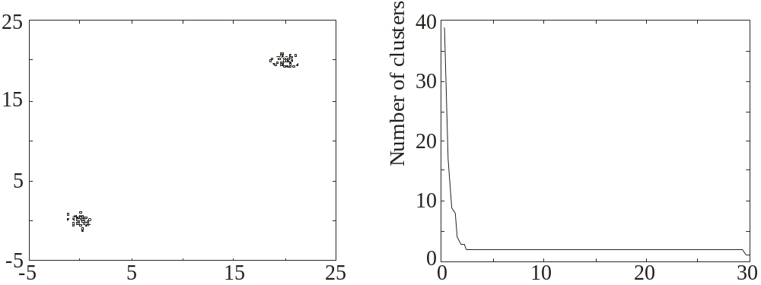
Estimating the number of clusters in the data set:
Let BSAS(Θ) denote the BSAS algorithm when the dissimilarity threshold is Θ.
  For Θ=a to b step c
    Run s times BSAS(Θ), each time presenting the data in a different order.
    Estimate the number of clusters m_{Θ}, as the most frequent number resulting from the s runs of BSAS(Θ).
  Next Θ
  Plot m_{Θ} versus Θ and identify the number of clusters m as the one corresponding to the widest flat region in the above graph.
Θ

Slide 80
MBSAS, a modification of BSAS
In BSAS a decision for a data vector x is reached prior to the final cluster formation, which is determined after all vectors have been presented to the algorithm.

Slide 81
MBSAS, a modification of BSAS
In BSAS a decision for a data vector x is reached prior to the final cluster formation, which is determined after all vectors have been presented to the algorithm.
  MBSAS deals with the above drawback, at the cost of presenting the data twice to the algorithm.

Slide 82


Slide 83
MBSAS, a modification of BSAS
Cluster Determination
  m=1 \ {number of clusters}\
  C_{m}={x₁}
  For i=2 to N
    Find C_{k}: d(x_{i},C_{k})=min_{1≤j≤m}d(x_{i},C_{j})
    If (d(x_{i},C_{k})>Θ) AND (m<q) then
      m=m+1
      C_{m}={x_{i}}
    End {if}
  End {for}

Slide 84

MBSAS, a modification of BSAS

Slide 85
MBSAS, a modification of BSAS
Remarks:
  decision for a vector x during the pattern classification phase is reached taking into account all clusters.
  still sensitive to the order of presentation of the vectors.
  requires two passes on the data. complexity is O(N).

Slide 86
The maxmin algorithm, a variant of MBSAS
Let X= the set of all data points
W = the set of all points that have been chosen to form clusters up to the current iteration step.

Slide 87
The maxmin algorithm, a variant of MBSAS
cluster formation:
    For each x∈X-W determine d_{x}=min_{z∈W} d(x,z)
    Determine y: d_{y}=max_{x∈X-W}d_{x}
    If d_{y} is greater than a pre-specified threshold then
      this vector forms a new cluster
    else
      the cluster determination phase of the algorithm terminates.
    End {if}
pattern classification:
assign each unassigned vector to its closest cluster

Slide 88
Remarks:
  The maxmin algorithm is more computationally demanding than MBSAS.
  However, it is expected to produce better clustering results.

Slide 89
A two-threshold sequential scheme (TTSAS)
  The formation of the clusters, as well as the assignment of vectors to clusters, is carried out concurrently (like BSAS and unlike MBSAS)
  Two thresholds Θ₁ and Θ₂ (Θ₁<Θ₂) are employed

Slide 90
A two-threshold sequential scheme (TTSAS)
  The general idea is the following:
    If the distance d(x,C) of x from its closest cluster, C, is greater than Θ₂ then:
      A new cluster represented by x is formed.
    Else if d(x,C)<Θ₁ then
      x is assigned to C.
    Else
      The decision is postponed to a later stage.
    End {if}

Slide 91
A two-threshold sequential scheme (TTSAS)
  The general idea is the following:
    If the distance d(x,C) of x from its closest cluster, C, is greater than Θ₂ then:
      A new cluster represented by x is formed.
    Else if d(x,C)<Θ₁ then
      x is assigned to C.
    Else
      The decision is postponed to a later stage.
    End {if}
The unassigned vectors are presented iteratively to the algorithm
until all of them are classified.

Slide 92
Remarks:
  In practice, a few passes (≥2) of the data set are required.
  TTSAS is less sensitive to the order of data presentation, compared to BSAS.

Slide 93
Refinement stages
Why necessary?
The problem of closeness of clusters: “In all the above algorithms it may happen that two formed clusters lie very close to each other”.

Slide 94
Refinement stages
  A simple merging procedure
    (A) Find C_{i}, C_{j} (i<j) such that d(C_{i},C_{j})=min_{k,r=1,…,m,k≠r}d(C_{k},C_{r})
    If d(C_{i},C_{j})≤M₁ then \{ M₁ is a user-defined threshold \}
      Merge C_{i}, C_{j} to C_{i} and eliminate C_{j} .
      If necessary, update the cluster representative of C_{i} .
      Rename the clusters C_{j+1},…,C_{m} to C_{j},…,C_{m-1}, respectively.
      m=m-1
      Go to (A)
    Else
      Stop
    End {if}

Slide 95
Reassignment of vectors
Why necessary?
The problem of sensitivity to the order of data presentation:
“A vector x may have been assigned to a cluster C_{i} at the current stage but another cluster C_{j} may be formed at a later stage that lies closer to x”

Slide 96
  A simple reassignment procedure
    For i=1 to N
      Find C_{j} such that d(x_{i},C_{j})=min_{k=1,…,m}d(x_{i},C_{k})
      Set b(i)=j \{ b(i) is the index of the cluster that lies closet to x_{i} \}
    End {for}
    For j=1 to m
      Set C_{j}={x_{i}∈X: b(i)=j}
      If necessary, update representatives
    End {for}

Slide 97

k-means Clustering
Partitional clustering approach
Each cluster is associated with a centroid (center point)
Each point is assigned to the cluster with the closest centroid
Number of clusters, k, must be specified
The basic algorithm is very simple

Slide 98

k-means Clustering
Initial centroids are often chosen randomly.
  Clusters produced vary from one run to another.

Slide 99
k-means Clustering
Points are distributed to the closest centroid.
‘Closeness’ is measured by Euclidean distance, cosine similarity, correlation, etc.

Slide 100
k-means Clustering
centroid is (typically) the mean of the points in the cluster.

Slide 101

K-means Clustering
centroid is (typically) the mean of the points in the cluster.

Slide 102
k-means Clustering
k-means will converge for common similarity measures

Slide 103
k-means Clustering
Most of the convergence happens in the first few iterations.
  Often the stopping condition is changed to ‘Until relatively few points change clusters’

Slide 104
k-means Clustering

Slide 105
k-means Clustering
k-means try to optimize an objective function

Slide 106

k-means Clustering
k-means try to optimize an objective function

Slide 107
Evaluating k-means Clusters
  Given two clusterings, choose the one with the smallest error
  An easy way to reduce SSE is to increase k
    A good clustering with smaller k can have a lower SSE than a poor clustering with higher k

Slide 108
k-means Clustering – Complexity
Storage Complexity is O ((m+k)n)
  m = number of points
  k = number of clusters
  n = number of attributes
Time Complexity is O(I* k * m *n )
  I = number of iterations

Slide 109



k-means may lead to suboptimal solution
Original Points
Optimal Clustering
Sub-optimal Clustering

Slide 110






Importance of Choosing Initial Centroids

Slide 111
Importance of Choosing Initial Centroids
find optimal SSE, although initial centroids are from one natural cluster

Slide 112





Importance of Choosing Initial Centroids …

Slide 113
Importance of Choosing Initial Centroids …
cannot find optimal SSE

Slide 114
Problems with Selecting Initial Points
If there are k ‘real’ clusters then the chance of selecting one centroid from each cluster is small.
  Chance is relatively small when k is large
  Consider an example of five pairs of clusters

Slide 115




10 Clusters Example
Starting with two initial centroids in one cluster of each pair of clusters

Slide 116
10 Clusters Example
Starting with two initial centroids in one cluster of each pair of clusters

Slide 117




10 Clusters Example
Starting with some pairs of clusters having three initial centroids, while other have only one.

Slide 118
10 Clusters Example
Starting with some pairs of clusters having three initial centroids, while other have only one.

Slide 119
Solutions to Initial Centroids Problem
Multiple runs
  Helps, but probability is not on your side
Sample and use hierarchical clustering to determine initial centroids

Slide 120
Solutions to Initial Centroids Problem
Select more than k initial centroids and then select among these initial centroids
  Select most widely separated
    can select outliers, too
Post-processing
Bisecting K-means
  Not as susceptible to initialization issues

Slide 121
Additional Issues: Handling Empty Clusters
Basic k-means algorithm can yield empty clusters
Several strategies
  Choose the point that contributes most to SSE
  Choose a point from the cluster with the highest SSE
  If there are several empty clusters, the above can be repeated several times.

Slide 122
Updating Centroids Incrementally
In the basic k-means algorithm, centroids are updated after all points are assigned to a centroid
An alternative is to update the centroids after each assignment (incremental approach)
  Each assignment updates zero or two centroids
  More expensive
  Introduces an order dependency!
  Never gets an empty cluster

Slide 123
Pre-processing and Post-processing
Pre-processing
  Normalize the data
  Eliminate outliers
Post-processing
  Eliminate small clusters that may represent outliers
  Split ‘loose’ clusters, i.e., clusters with relatively high SSE
  Merge clusters that are ‘close’ and that have relatively low SSE

